Slide 1

Cancellation reduction in the hospitality industry Hanif K

Slide 2
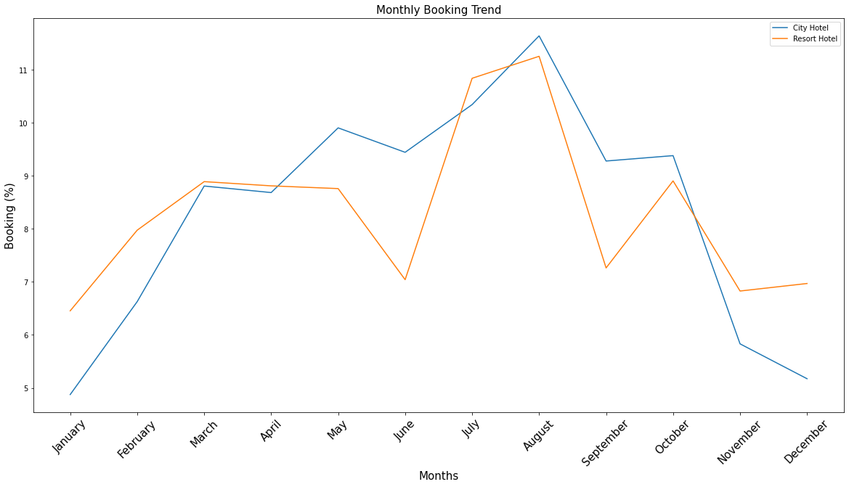
Insight
Majority of bookings for both hotels are between June and September

Slide 3
What does this mean for us?

Slide 4

The majority of our bookings are in a short window. We want to reduce cancellations !

Slide 5

Insight on our customers!
Average booking is worth:
Gross: €652
Industry standard – 30% profit per room.
Net: €195 profit per room.
Measuring and Understanding Hotel Profits; Profit and ProfPAR Defined.
Rohlf, Kristin, Hospitality Research Group of PKF Consulting:

Slide 6

Baseline Assumption 100% Check in

Slide 7
Unrealised profit
8063 Cancellations
€195 profit per booking
€ 1,677,585
Unrealised Profit

Slide 8
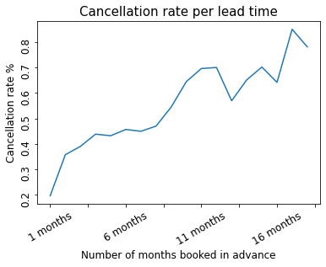
Correlations
Advanced Booking
Cancellation

Slide 9
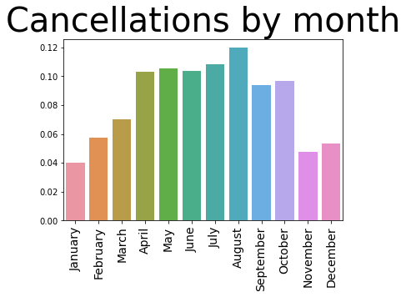
Aug
May
July
Highest cancellations

Slide 10

How did our model perform?

Slide 11
Model Performance - 20% intervention success
8063 Cancellations
20% Intervention
€ 1,539,653
Unrealised Profit

Slide 12

How much money can we recoup?
Baseline unrealised profits
Model Unrealised profits
€137,931
Profit
Or 8.2% reduction in profit loss

Slide 13
Intervention recommendations:
Recommendations:
1) 10% discount on rooms
2) Rooms D ,Free upgrade to Room E. (€4 difference)
3) Couples massages vouchers.
4) Family Activities. 7% are coming with children.
5) Contact customers who have booked far in advance to offer them discounts/vouchers.

Slide 14
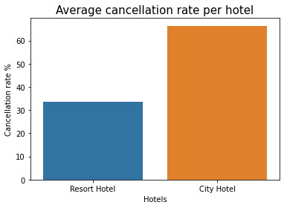
Further Analysis
Look into City hotel specifically and try to reduce cancellations.

